Slide 1
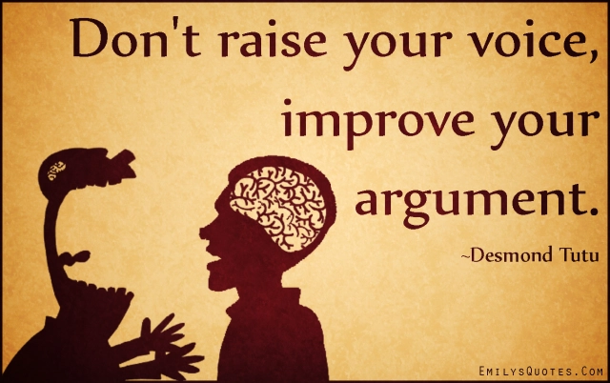

Slide 2
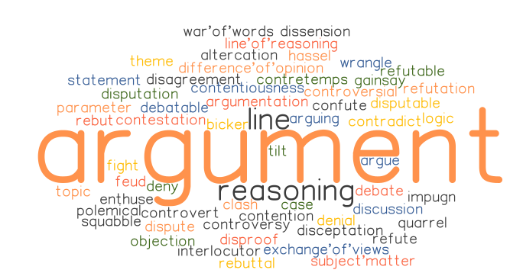

Slide 3
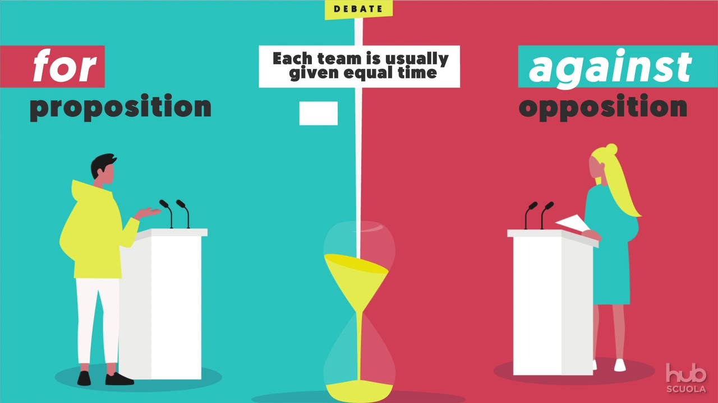
A DEBATE

Slide 4
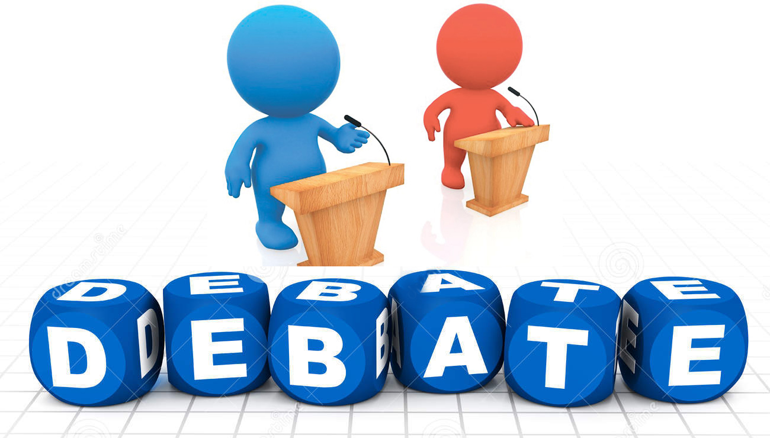
A debate is an organized argument or contest of ideas in which the participants discuss a topic from two opposing sides.

Slide 5
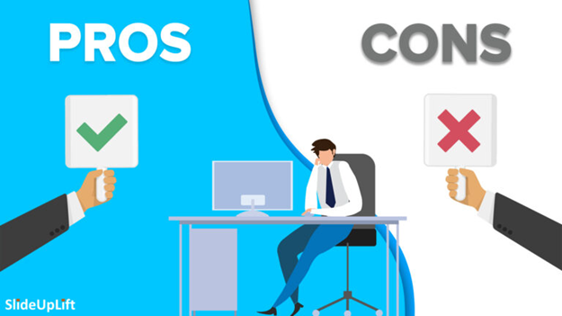
﻿Debate is like an intellectual sport where you have to learn the skills to win.
For example, in order to win a debate round, you need to have a full understanding of the topic you are debating about.
agree
disagree

Slide 6


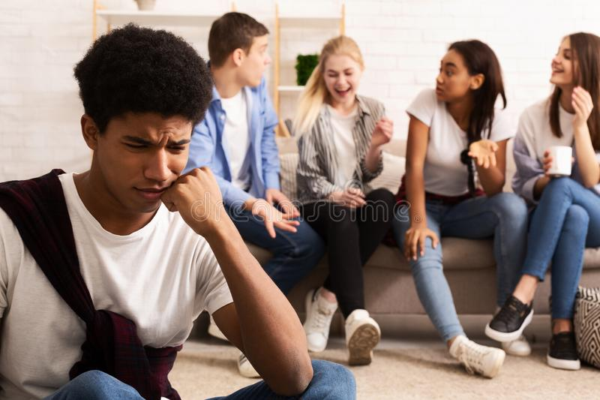
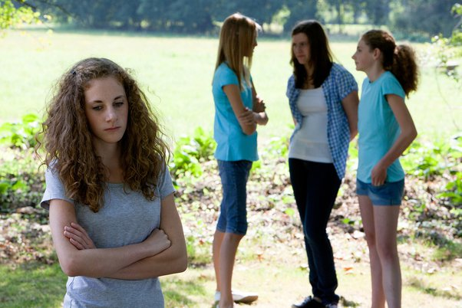
OUR TOPIC
QUIET, SHY PEOPLE ARE LESS INTERESTING
PRO: Eva and Alen CON: Andrej and Vedad

Slide 7
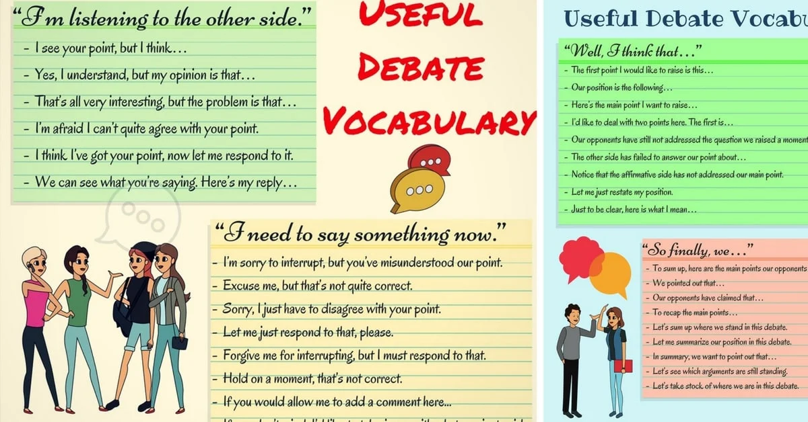

Slide 8
OUR DEBATE FORMAT

Slide 9
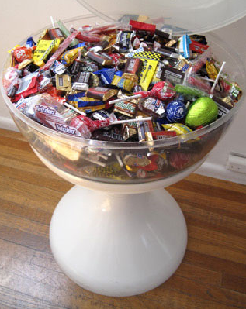
Workshop 1
LET‘S GET TO KNOW EACH OTHER

Slide 10

Workshop 2
LOGO MAKING

Slide 11

workshop 3
FILLERS

Slide 12
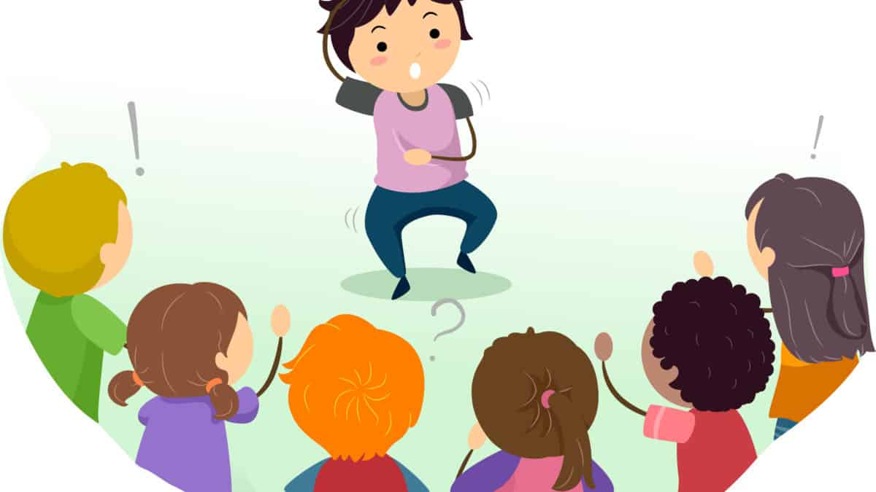
Worshop 4
NON VERBAL COMMUNICATION

Slide 13
Workshop 5
TONE
1. Almost every time you turn on a TV, you will find a number of shows which are extremely violent.
2. Many public schools have decided that their students should wear uniforms.
3. Every culture has their own understanding of what it means to be a hero.
4. Today smoking is an issue which is on everybody‘s mind.

Slide 14
5. Teachers at this school have the knowledge and skills to do their job well.
6. Superman appears as a comic book character and also his movies have been made.
7. There are a total of 195 countries in the the world and there are 7 continents.
8. There are still species in the world that we have never encountered.
9. North Korea is a country that is not allowed to buy Coca-Cola products.
10. Teenagers have less self-control, they are very impulsive.

Slide 15

TONGUE TWISTERS
Workshop 6

Slide 16
Word stressing
A neighbor's cat overturned flowers in front of the house again yesterday.
A neighbor's cat overturned flowers in front of the house again yesterday.
A neighbor's cat overturned flowers in front of the house again yesterday.
A neighbor's cat overturned flowers in front of the house again yesterday.
A neighbor's cat overturned flowers in front of the house again yesterday.
A neighbor's cat overturned flowers in front of the house again yesterday.
A neighbor's cat overturned flowers in front of the house again yesterday.
A neighbor's cat overturned flowers in front of the house again yesterday.

Slide 17

TOURNAMENT

Slide 18
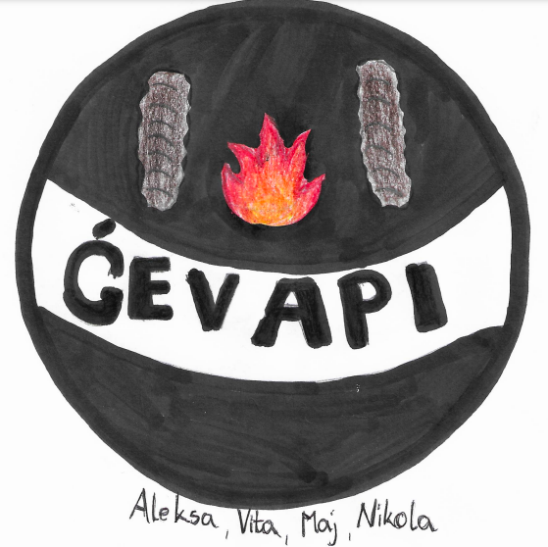

Slide 19
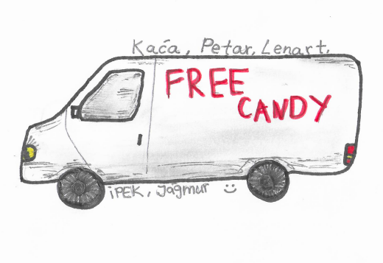

Slide 20
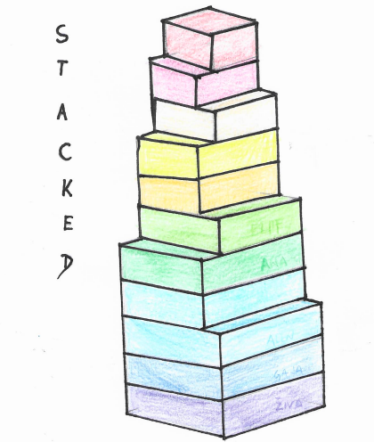

Slide 21
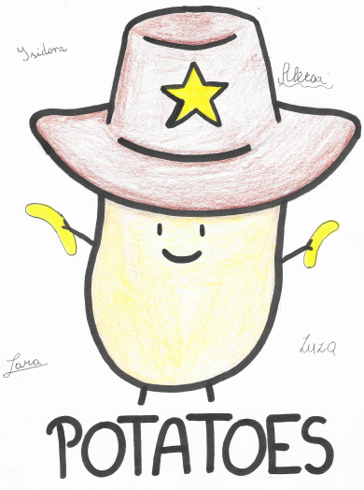

Slide 22
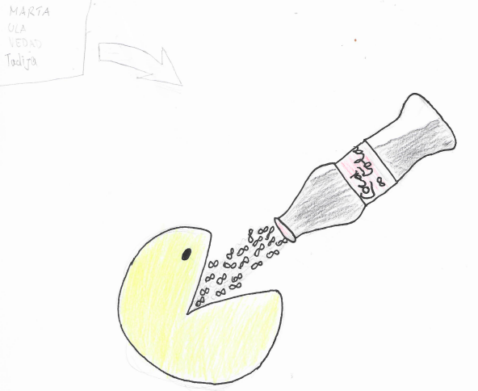

Slide 23
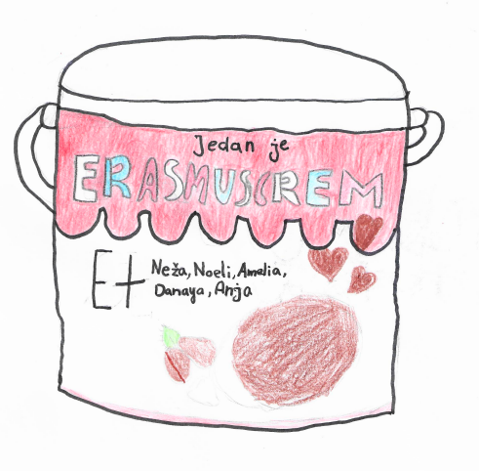

Slide 24
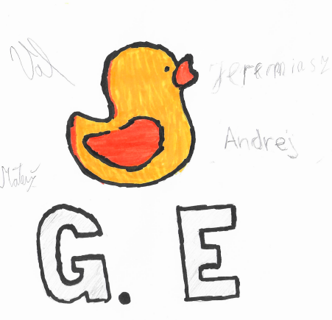

Slide 25
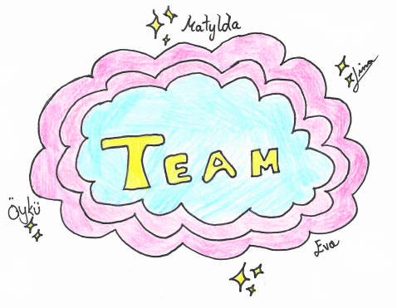

Slide 26
